Slide 1
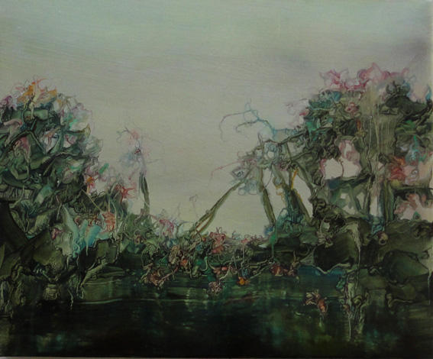

Placed Based Narratives and Contemporary Social Representations of English Wetlands
WetlandLIFE project July 2017- January 2020
WetlandLIFE: taking the bite out of wetlands
www.wetlandlife.org
@wetlandlife
Michele Fletcher: Morass

Slide 2
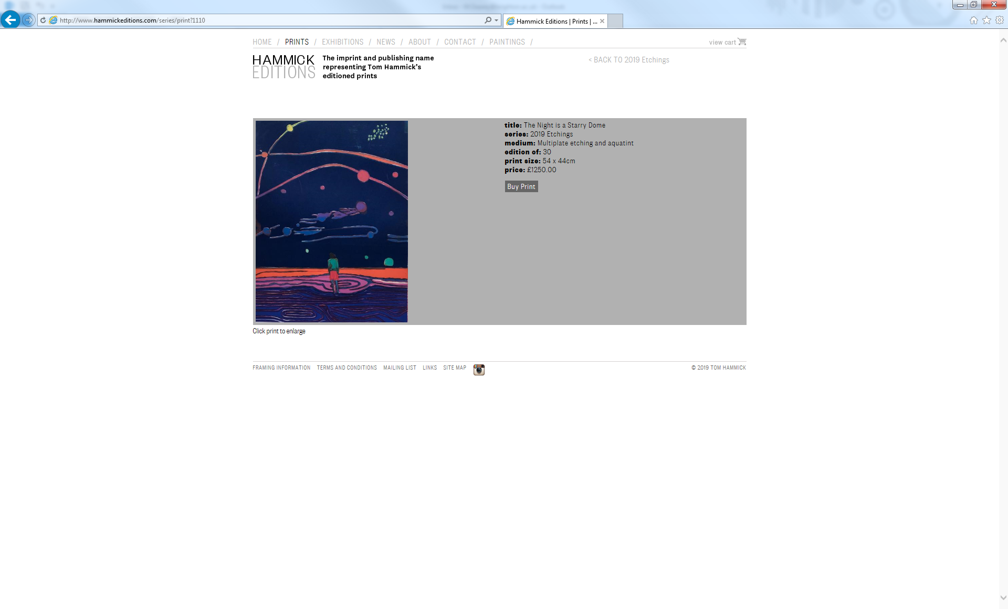
Entomology
WetlandLIFE is a project exploring the ecological, economic, social and cultural values associated with wetlands in England to better understand how to manage change into the future.
Economics
WetlandLIFE Team
Environmental
History
Art & Literature
Social Science
University of Brighton’s Social Science research
Contemporary Social Representations (CSR)
Place Based Narratives (PBN)
AIM: To understand how English wetlands are co-constituted by socio-cultural values; how society and culture are shaped by English wetlands.
To explore tensions which exist between different domains of knowledge, such as landscape planning, water resources management, legal frameworks and art, amongst many others, in ‘knowing’ wetlands.
To understand how these perspectives directly influence how we use and value wetlands today, interrogating understandings of what wetlands ‘are’, as a way of moving towards sustainable futures.
Aim: To understand a ‘sense of place’ that is generated through diverse human relationships within wetland spaces.
To identify if mosquitoes impact on these human-wetlands experiences. Working together with the CVM approach to enable a fine-grained depiction of viewpoints, to interrogate the ways in which human health and wellbeing features within these narratives.
To use these findings together with WetlandLIFE’s ecological, entomological and economic work to support evidence based recommendations for wetland site managers.
Tom Hammick: The night is a starry dome

Slide 3
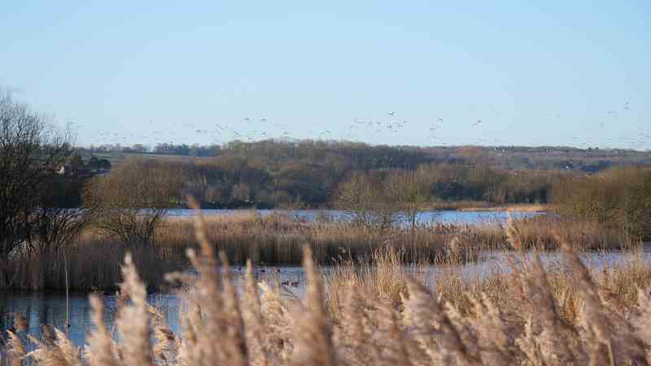
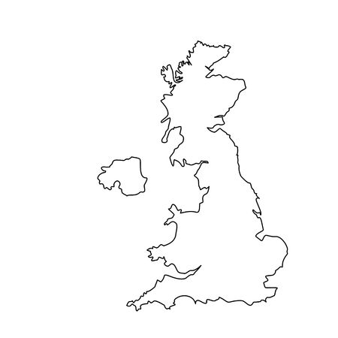
University of Brighton’s methodology:
Somerset Levels: Westhay Moor and Shapwick Heath
Bedfordshire: Priory Country Park & Millennium Country Park
North Lincolnshire: Alkborough Flats
Desk based study, spanning the duration of the project, exploring the ‘domains of knowledge’ which have shaped our contemporary wetland spaces, and the co-constituted social and cultural representations which underpin how we use and value these waterscapes.
Background research to identify specialist users groups within all three sites.
Qualitative, semi structured interviews, ten per site.
Working only with specialist interest groups; University of Greenwich’s CVM focused on cohort from the local wetland communities.
To talk with those who use the wetlands and to access groups who could use these wetlands but choose not to use these spaces.
Preliminary focus groups held in Bedfordshire and Somerset to contextualise the range of issues impacting on the wetland sites.
Work took place between January and September 2018.
All interviews were recorded and have been transcribed.
Somerset Levels: Shapwick Heath (Adriana Ford)

Slide 4
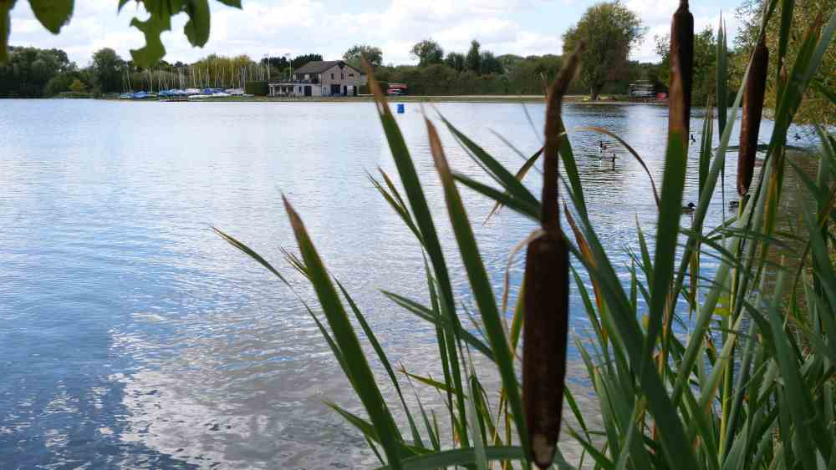
Results
Botanists, walkers, birders, artists, environmentalists, foragers, landowners, spiritual or religious practitioners, archaeologists, historians, educators, youth and community workers, health and wellbeing practitioners were among those interviewed.
Other groups were deselected for research ethics reasons: these would include minors, homeless campers, those involved in delinquent or illegal activity.
Our findings fall into four categories:
English wetlands as ludic spaces for recreation and play, supporting physical and relational wellbeing
English wetlands as artistic spaces, supporting cultural and creative engagements
English wetlands as remembrance spaces, supporting emotional wellbeing
English wetlands as exemplary landscapes within transitions towards sustainable futures
Bedford Priory Country Park marina (Adriana Ford)

Slide 5
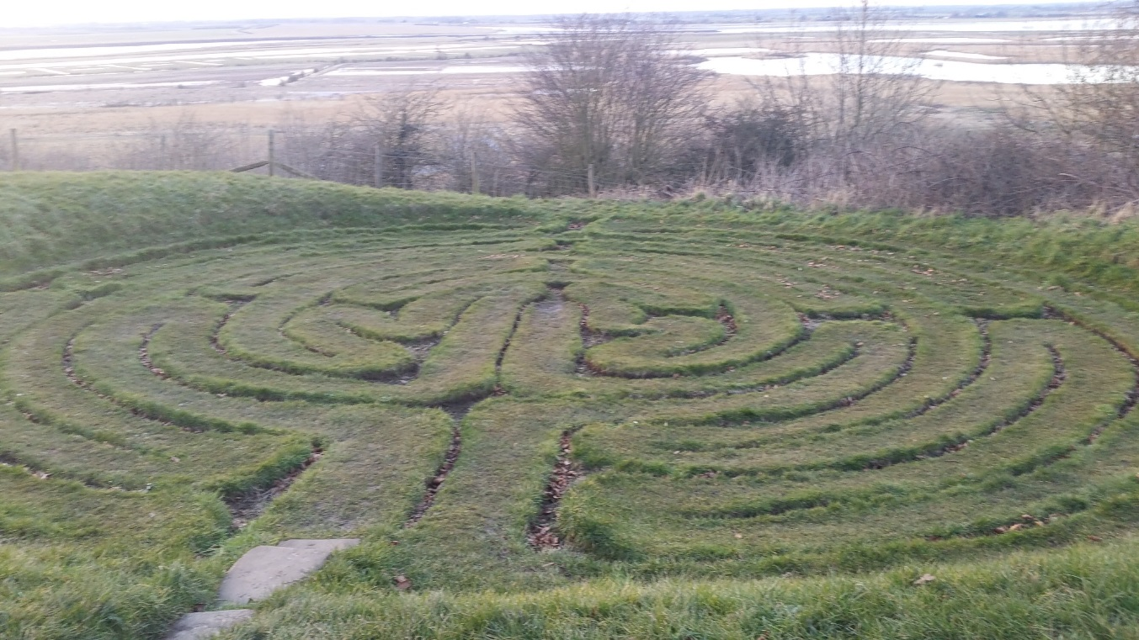
English wetlands as ludic spaces for recreation and play, supporting physical and relational wellbeing
Wetlands as learning spaces – individual and group activities
Wetlands repositioned as places of recreation, particularly around family time
Places in which expertise develops – from hobby to forms of career development and life stage adaptation
Emphasis is placed on engaging people at a young age and supporting on-site learning
Access, safety and perceptions of risk play a part in deterring people from enjoying wetland spaces
Julian’s Bower overlooking Alkborough Flats: (Mary Gearey)

Slide 6
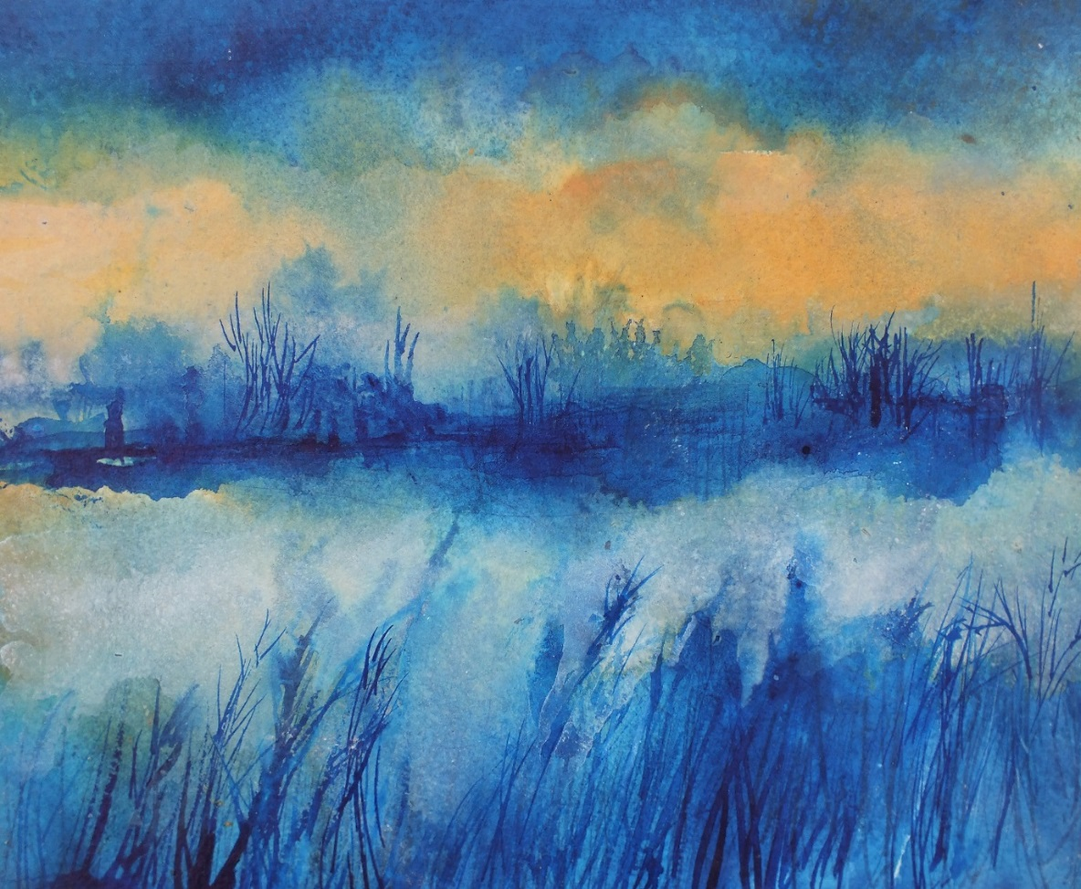
English wetlands as artistic spaces, supporting cultural and creative engagements
Wetlands as inspirational, emotive landscapes which enable forms of writing, painting, film-making
Literature is a key part of this – from Classical works and New Nature Writing to the English Eerie and Pastoral Noir
Self expression in all forms supporting mental wellbeing
The importance of the Art economy to these rural spaces - festivals, workshops, courses inspired by these waterscapes
The project artists have highlighted social equity issues – the need to bring wetlands to communities with less access, less desire to dwell within these spaces
Margaret Micklewright: Shapwick Heath at dusk

Slide 7
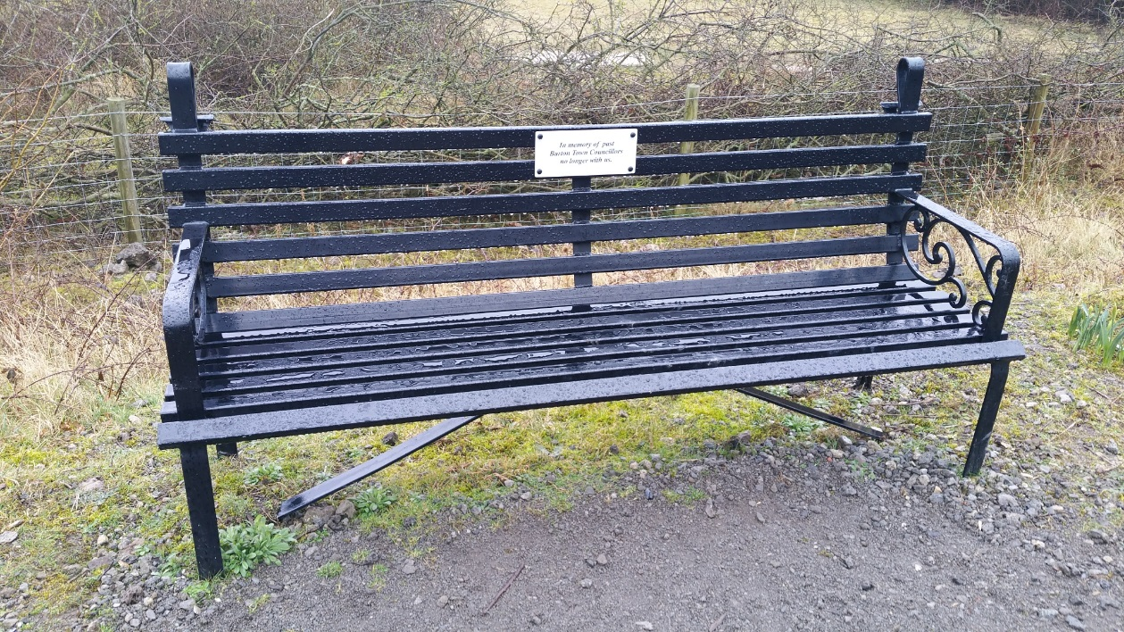
English wetlands as remembrance spaces, supporting emotional wellbeing
Places for commemoration – tree planting, ash scattering, memorial benches, paeans to loved ones past and present
Creating memories –family activities, third age rejuvenation, murmurations, ‘delinquency’ and counter cultures
Spaces in which to contemplate other human lives and deep time – Neolithic trackways, Roman turf mazes, artillery and ordanace sites, post industrial
Wetlands as liminal, threshold spaces, connecting us with other humans and the more-than-human
Recognition that these are inclusive spaces for all forms of human and more-than-human life
Memorial bench: Millennium Country Park, Bedfordshire (Mary Gearey)

Slide 8
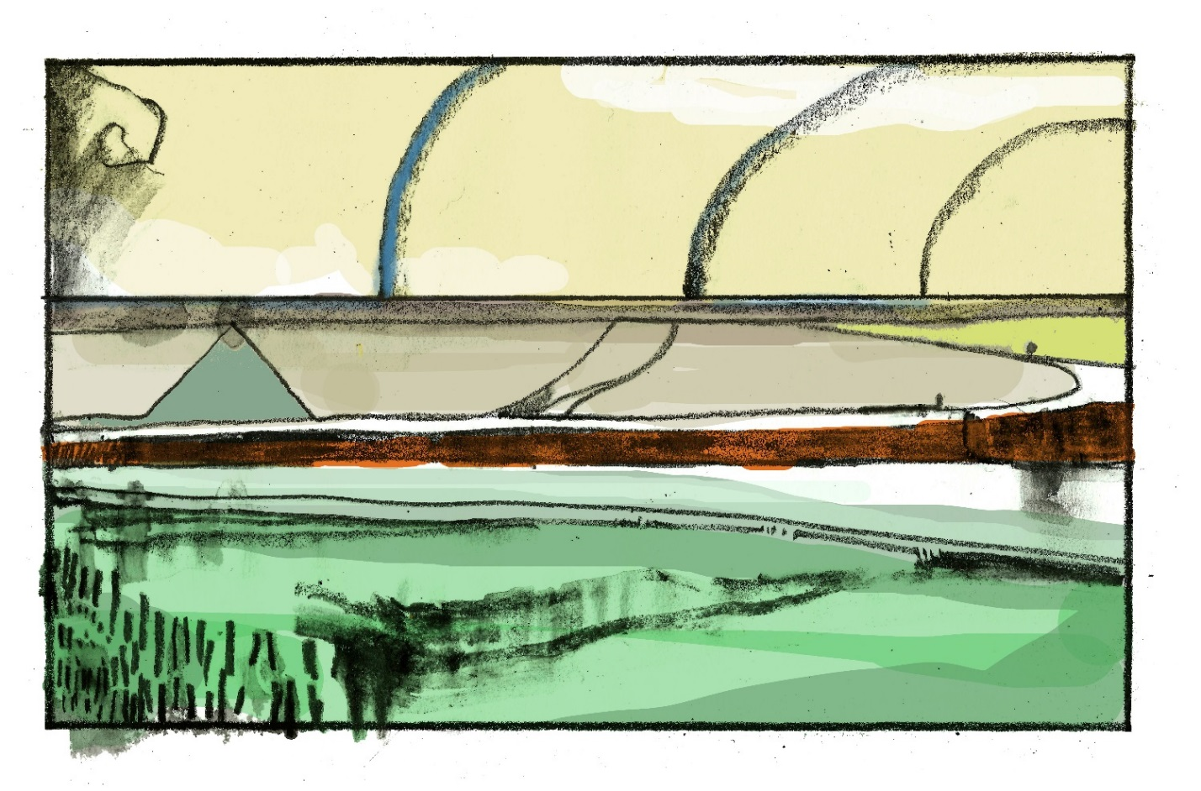
English wetlands as exemplary landscapes within transitions towards sustainable futures
Wetlands are exemplary landscapes in support of sustainability transitions
Nature based solutions and green-blue infrastructure
Biosecurity – mosquitoes as vectors
Land management in post Brexit era
Wetland grabbing – green gentrification and social justice
Terrain vague and shifting mindsets towards challenging landscapes
Heritage, ecosystems services and legacy
Memorial bench: Millenium Country Park, Bedfordshire (Mary Gearey)
Maxim Peter Griffin: Alkborough Flats

Slide 9
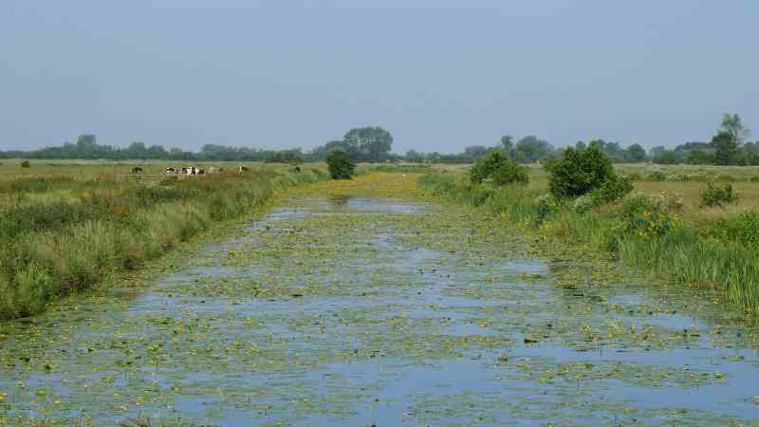
English wetlands: key reflections & recommendations
Improve access to, and on, the sites
Widen diversity across different demographic spheres through outreach
Communicate wetlands as adaptation and mitigation spaces
Connect with creative practitioners
Engage with pedagogic learning on-site
Somerset Levels: Westhay Moor (Adriana Ford)

Slide 10


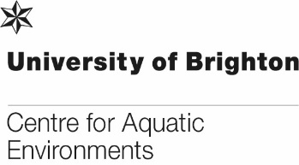
University of Brighton team
Dr Mary Gearey
M.Gearey@brighton.ac.uk
Professor Andrew Church
A.Church@brighton.ac.uk
Professor Neil Ravenscroft
Neil.Ravenscroft@rau.ac.uk
Forthcoming from Palgrave Macmillan:
English wetlands: spaces of nature, culture, imagination
Mary Gearey, Andrew Church, Neil Ravenscroft

